Slide 1

Please enter your name and clinic in the chat to register attendance.
We will review at the end of the session.

Slide 2

Alabama Care Network SOUTHEAST Medical Management Meeting
December 2025
Notes:
Thanks everybody for being here. We'll go ahead and get started. and be mindful of your time. This is our fourth quarter of the fiscal year with our medical management meeting, so I appreciate everybody taking their time to attend.

Slide 3

EPSDT Manual Changes
ALERTS
Quality Reports
This Photo by Unknown Author is licensed under CC BY-SA
Notes:
I think we have a nice agenda. We’re going to take a look at a process to improve diagnostic accuracy, benefitting patients and providers with safe, quality care. Then we will review some recent ALMC alerts. We will also just give a brief review of our quality data. As always feel free to jump in. I will pause at certain parts to see if there are questions. You are also welcome to put questions in the chat. I will check when I get to a stopping point. And then I will go over those.

Slide 4
Advancing EPSDT: Engaging Families and Addressing Social Determinants of Health

Slide 5
EPSDT and Social Determinants of Health: A Critical Intersection
EPSDT ensures comprehensive screenings for Medicaid patients <21, but outcomes are limited without addressing SDOH (e.g., housing, food insecurity, transportation).
SDOH impacts 50-80% of health outcomes (NEJM, 2023).
Goal: Integrate SDOH screening and family engagement to improve compliance and health equity.

Slide 6
Barriers to Family Engagement in EPSDT
Structural: Lack of trust in healthcare systems, historical inequities.
Logistical: Transportation, childcare, or work conflicts.
Psychosocial: Low health literacy, cultural misalignment, fear of stigma (e.g., reporting SDOH issues).

Slide 7
Evidence-Based Family Engagement Strategies
Shared Decision-Making (SDM): Use motivational interviewing to align EPSDT goals with family priorities (e.g., child’s school performance).
Peer Navigators: Train community health workers (CHWs) with lived experience to build trust and guide families.
Trauma-Informed Care: Adopt trauma-sensitive approaches to address adverse childhood experiences (ACEs).

Slide 8
Evidence-Based Family Engagement Strategies
Culturally Tailored Outreach: Develop multilingual, culturally relevant materials (e.g., videos, flyers) co-designed with community input.
Family-Centered Scheduling: Offer group visits or co-located services (e.g., WIC, social work) to reduce barriers.
Behavioral Nudges: Use personalized reminders (e.g., text messages framed as “Your child’s health check is ready!”).

Slide 9
Periodicity Schedule
• 3-5 day old
• 1 month
• 2 months
• 4 months
• 6 months
• 9 months
• 12 months
• 15 months
• 18 months
• 24 months
• 30 months
• Then annually (per calendar year) through 20 years of age beginning with the third birthday

Slide 10
Periodicity Schedule
• 3-5 day old
• 1 month
• 2 months
• 4 months
• 6 months
• 9 months
• 12 months
• 15 months
• 18 months
• 24 months
• 30 months
• Then annually (per calendar year) through 20 years of age beginning with the third birthday

Slide 11
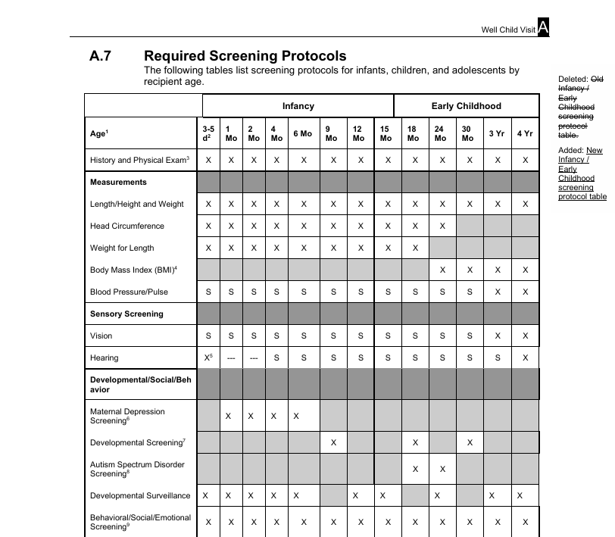

Slide 12
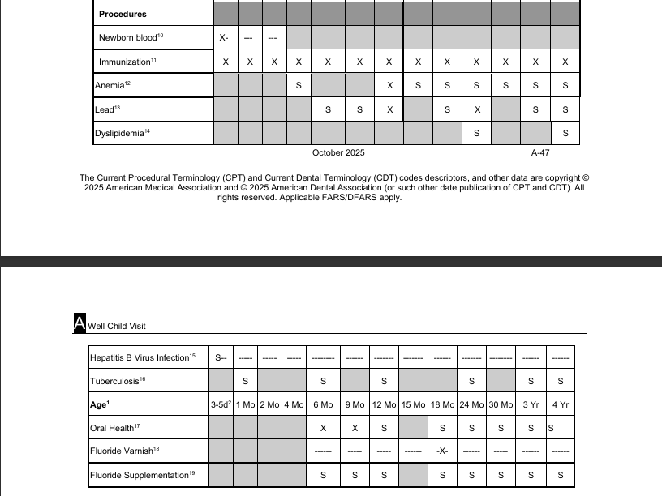

Slide 13
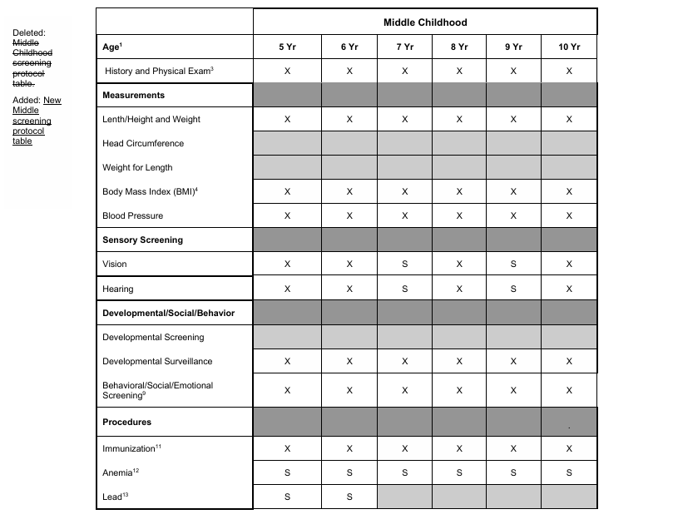

Slide 14
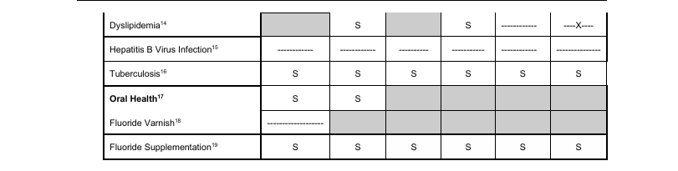

Slide 15
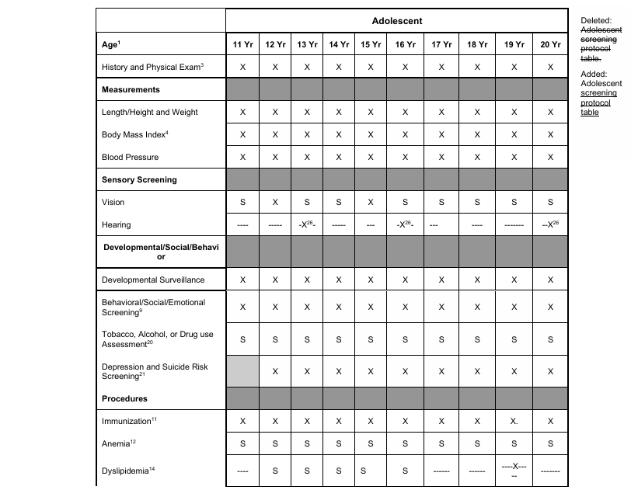

Slide 16
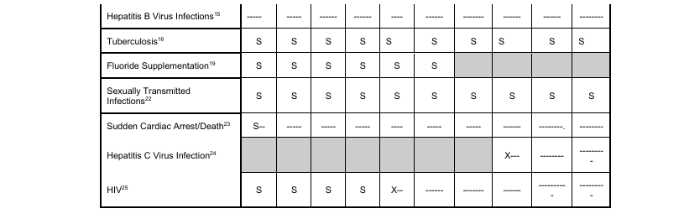

Slide 17
Unique Viewing Code
12026

Slide 18
Developmental Screening
Required at
9 month
18 month
30 month
96110 – Developmental testing

Slide 19
Developmental Screening Standardized Screening Tool
Ages and Stages Questionnaire (ASQ)
Denver DST/Denver II
Battelle Developmental Screener
Bayley Infant Neurodevelopment Screener (BINS)
Parents Evaluation of Development (PEDS)
Early Language Accomplishment Profile (ELAP)
Brigance Screens II
Pediatric Symptom Checklist (PSC)

Slide 20
Behavioral/Social/Emotional Screening
Screening for behavioral and social-emotional problems in children and adolescents should be family centered and may include asking about caregiver emotional and mental health concerns and social determinants of health, racism, poverty, and relational health.
Required at each EPSDT 3-5 days to 20 years

Slide 21
Autism Screening (M-CHAT)
Required at 18 month and 24 month.

Slide 22
Brief Emotional and Behavioral Assessment
Ages and Stages Questionnaire/ Social Emotional (ASQ-SE)
Modified Checklist for Autism in Toddlers (M-CHAT)
NICHQ Vanderbilt Assessment Scales
Behavior Assessment Scale for Children Second
Patient Health Questionnaire (PHQ – 2 AND PHQ – 9)
Pediatric Symptom Checklist (PSC)

Slide 23
Brief Emotional and Behavioral Assessment
Done at each EPSDT from 3-5 days to 20 years, up to 3 units.
96127 – Brief emotional/behavioral assessment
Ages and Stages Questionnaire/ Social Emotional (ASQ-SE)
Modified Checklist for Autism in Toddlers (M-CHAT)
NICHQ Vanderbilt Assessment Scales
Behavior Assessment Scale for Children Second
Patient Health Questionnaire (PHQ – 2 AND PHQ – 9)
Pediatric Symptom Checklist (PSC)
Edinburgh Maternal Depression Screen

Slide 24
Depression and Suicide Risk Screening
Required annually 12-20 years.

Slide 25
Vision and Hearing
Vision annually from 3-6 years, 8, 10, 12, 15
Hearing at birth and annually from 4-6, 8, 10
Hearing once from 11-14 years, 15-17 years, 18-20 years

Slide 26
Dyslipidemia
Provide risk assessments if positive family history for dyslipidemia, obtain fasting lipid.
If no family history, obtain fasting lipid provide between ages 9y – 11y and 17y – 20y.

Slide 27

Quality Report Review
Dietitian Referral Reminder

Slide 28
ACHN Contact information
Michael J. Ramsey, M.D., F.A.A.P. – Medical Director mramsey@dpeds.org or mj_ramsey@msn.com 334-793-1881
Kim Eason – Director keason@uabmc.edu 334-703-4565
Mary Roedl, Interim Care Management Director mroedl@uabmc.edu
334-451-0493
Adam Eason - akeason@uabmc.edu 334-703-2510
Amy Donaldson, PharmD – Pharmacy Director adonaldson@uabmc.edu 334-744-2565
Referrals – (334) 466-4609 – Fax referral form or Face Sheet with Patient information and contact information
Notes:
I've included our contact information. Will send out copies of this presentation afterward. Please continue to send us your referrals. We find them very helpful. Our patients find them helpful and we love seeing the good outcomes from that.

Slide 29

Thank You For Your Time
Medical Management Meeting Schedule
December 2nd, 3rd and 4th
All meetings will be via webinar at 12:00 p.m. Central Time

